Slide 1

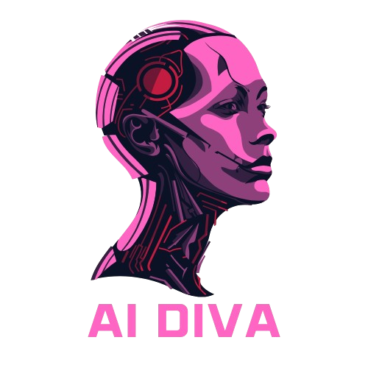


Meet Your A.I. Diva!
A Fun, Sassy Guide to A.I. Communication
Rebecca Rahman, My Tran, Gabriel Sosa

Slide 2
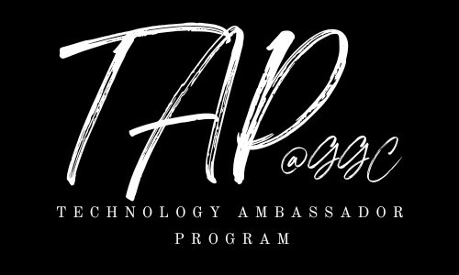
What is the TAP Program?
Technology Ambassador Program (TAP) promotes outreach, engagement, and active learning.
Mission: Encourage tech education through hands-on projects.
TAP students design engaging and fun outreach workshops to encourage interest in IT and STEM.

Slide 3
Project Goals – Why A.I. Diva?
Audience: Students, educators, tech enthusiasts.
Why this project? Engage learners and improve AI interactions.
Focus: Outreach, engagement, and active learning through hands-on experience.

Slide 4
What is A.I.?
A.I. (Artificial Intelligence) helps machines think and learn like humans.
Learns from data to improve over time (e.g., Netflix recommendations).
Understands language (e.g., chatbots like A.I. Diva, Siri).
Recognizes images (e.g., face unlock on phones).
Automates tasks (e.g., self-driving cars, spam filters).

Slide 5

Beginning
Start from going onto D2L and finish your pre survey quiz to test your AI skills.
Do you use Chat GPT?
How often do you use A.I. in your daily life?

Slide 6

Welcome to the A.I. Diva Experience!
• Chat with a sassy, smart AI!
• Learn how to give clear instructions.
• Get roasted if you don’t—let’s dive in!

Slide 7
How It Works
Tutorial: Quick guide for beginners.
Chat with AI Diva and get witty responses.
The clearer your prompts, the better your answers!

Slide 8

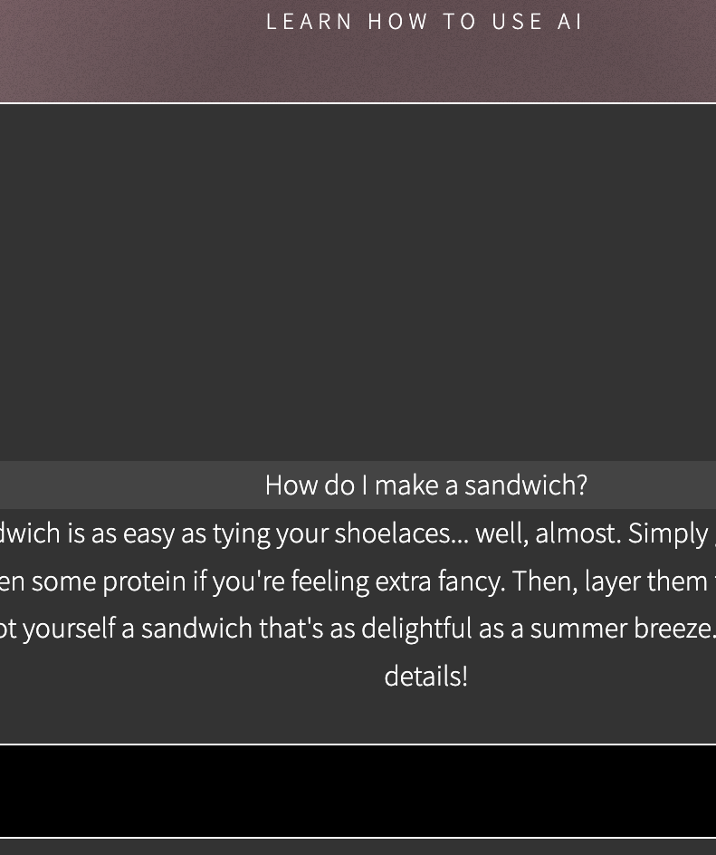

First Impressions Matter!
Be specific or get sass!
Example: - We ask: 'How do I make a sandwich?'
- AI Diva: 'Not your personal chef! Be more specific!'
Activity: Submit vague prompts and see how AI reacts.

Slide 9
From Confusion to Clarity
Clearer questions = better responses.
For Example:
- Vague: 'How do I cook?'
- Better: 'How do I boil water for pasta?'
Activity: Rewrite vague questions to be more specific.

Slide 10
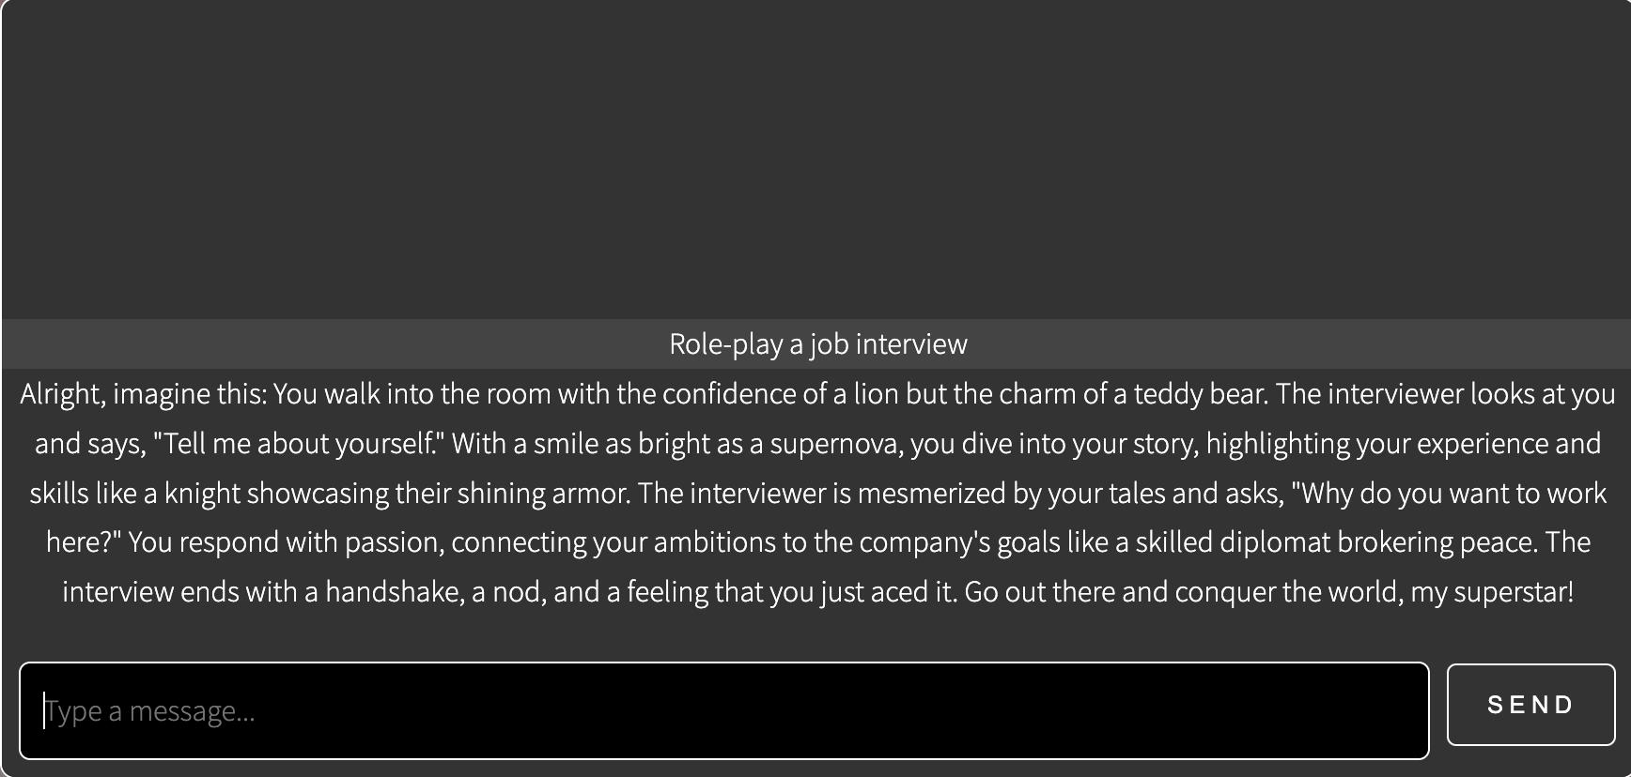
The Art of AI Conversations
AI is about interaction, not just answers.
Example: - Role-play a job interview.
- Solve a problem together.
Activity: Keep the conversation going with follow-up questions.

Slide 11
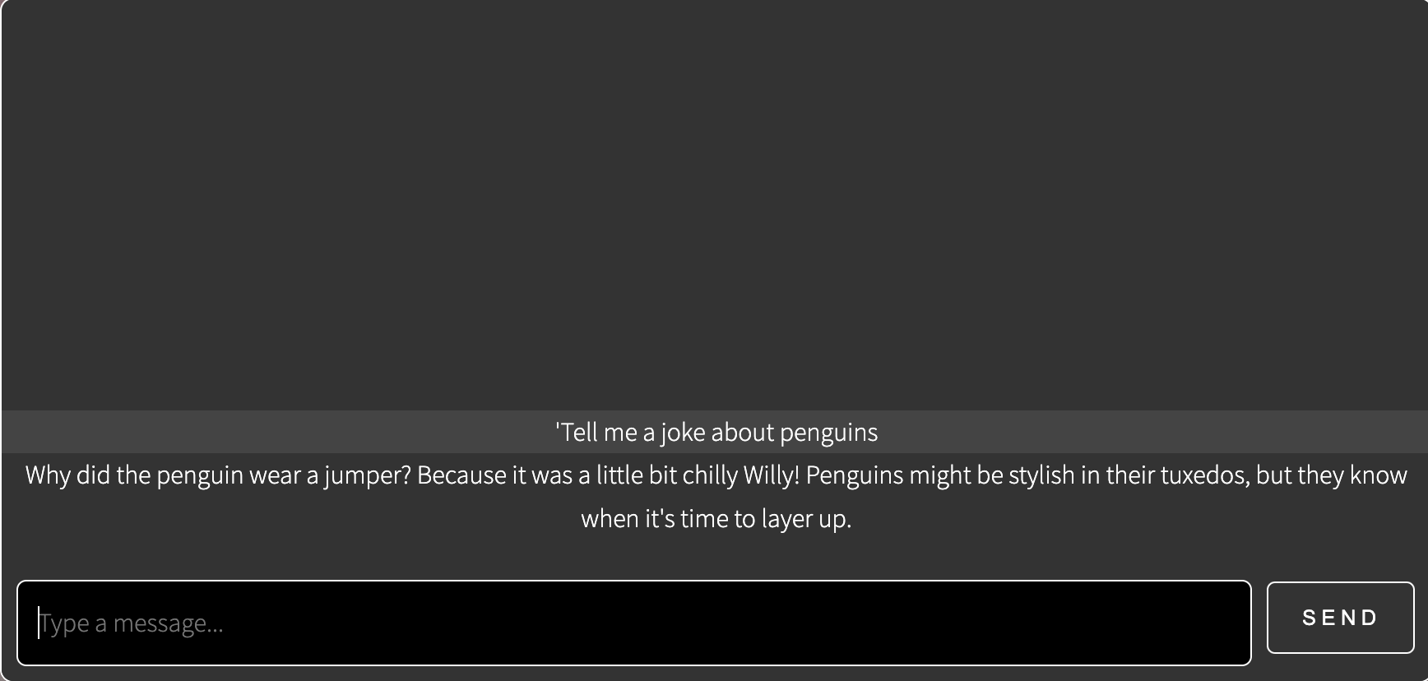
Get Creative with AI Diva
Context makes AI smarter.
Example: - We ask: 'Tell me a joke!'
- AI Diva: 'How original. AI jokes are artificially funny.'
Activity: Try adding details, like 'Tell me a joke about penguins'.

Slide 12
AI Diva’s Challenge Mode!
Practice good prompts to become AI pros.
Example challenges:
- Ask for a recipe.
- Write a short story prompt.
- Get a book recommendation.
Activity: AI Diva rewards good prompts and roasts bad ones!

Slide 13
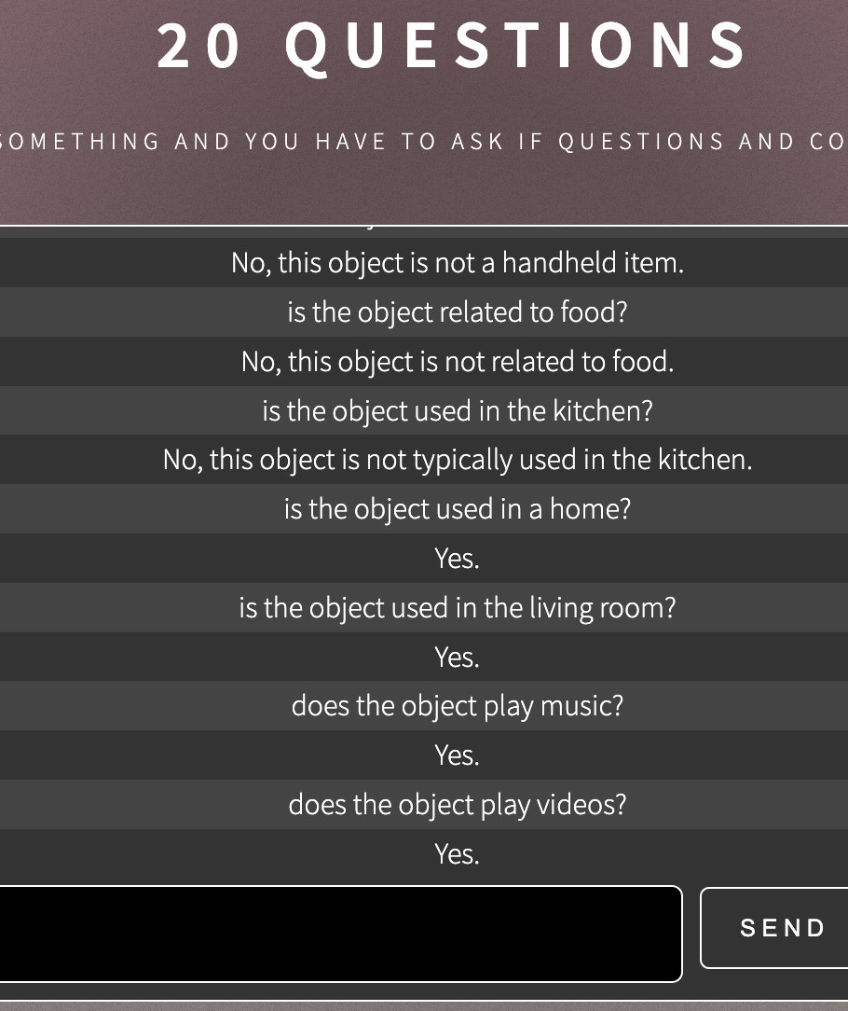
20 Questions
Going to the website click on the mini game button
Now we will ask a series of yes/no questions to the A.I
Being specific will help us figure out what the A.I. is thinking of

Slide 14
Wrapping Up – Are We AI Masters Yet?
Recap:
- Be specific.
- Add context.
- Keep conversations going.
Final Challenge: Take a quiz to test your AI skills onto D2L.
Download your AI Diva Certificate!

Slide 15
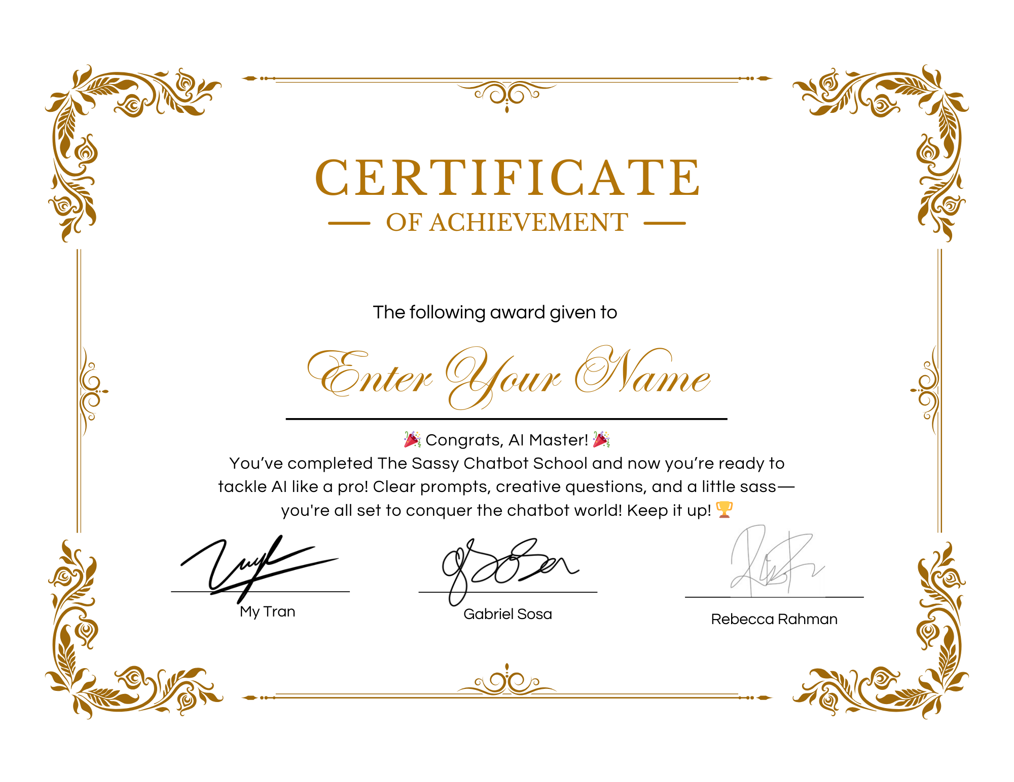

Slide 16
Thank You & Have Fun!
Now you’re all A.I. pros—time to practice!
A.I. responds based on how we ask questions.
Stay smart, stay sassy, and keep experimenting! 🚀

